Slide 1
Climate Change project update: week 3
Rens Breunissen,
Lotte van Dongen,
Markus Peschl,
Cecilia Casolo,
Maaike Elgersma,
Eva Slingerland,
Simon van Oosterom
Supervised by
Lorinc Meszaros [Deltares]
Robbert Fokkink [TU Delft]
Mathematical Data Science

Slide 2
Github
We used a Github drive in order to share codes and results. You can join the drive and view our progress with the following link:

Slide 3
This week we worked on:
We expanded the clustering algorithms and analysis
We worked on Neural Networks in order to make predictions

Slide 4
Clustering
As can be seen in last week’s presentation, the analysis does not vary wildly from station to station
We generated the clusters for all models and scenarios for station Marsdiep
For this station, we analyzed the behaviour of all clusters

Slide 5
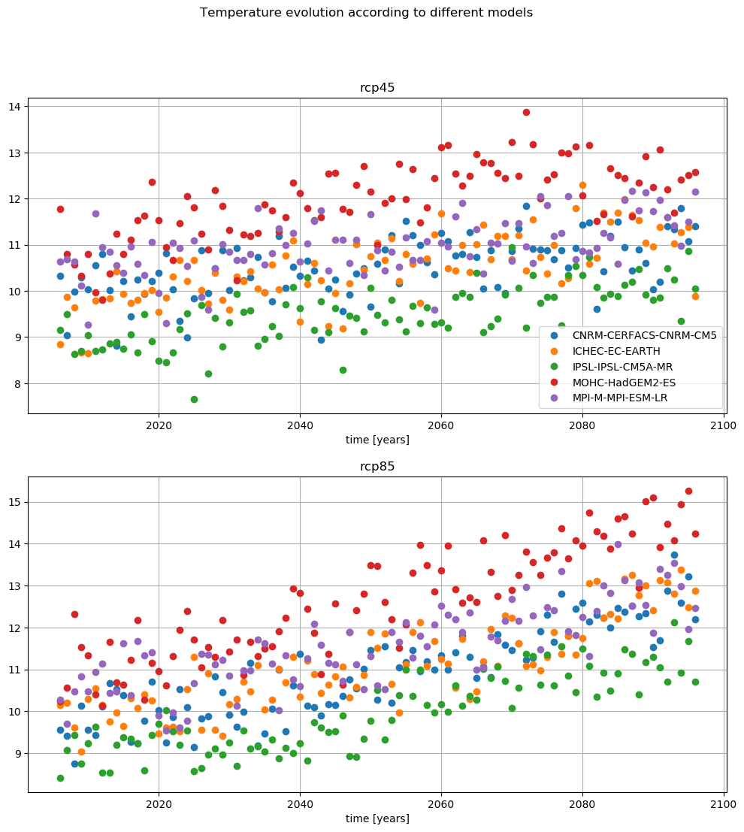
Analyzing the clusters
Figure from the pre-analysis
As an example we can compare two models with the two different scenarios.
Here, one can see that the MOHC predicts an extreme rise in temperature while CNRM is more or less the average of the models, so we can compare those

Slide 6
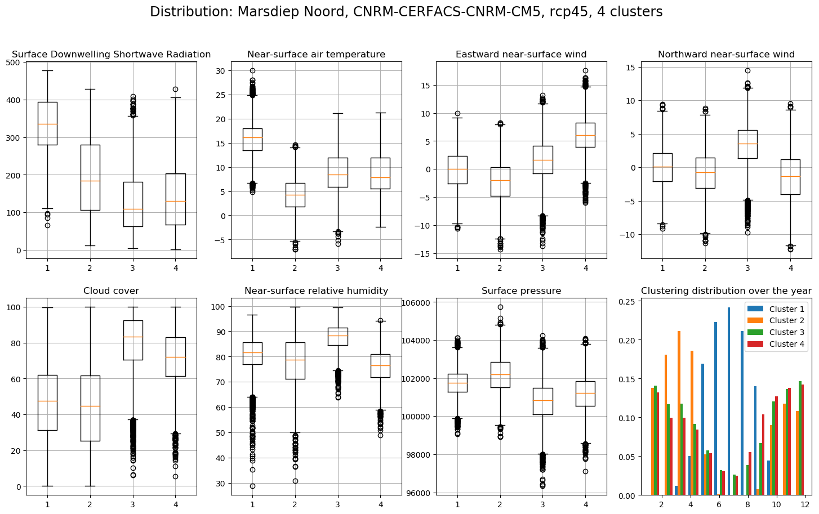
Analyzing the clusters
This is the figure from last week, CNRM model with optimistic scenario and 4 clusters

Slide 7
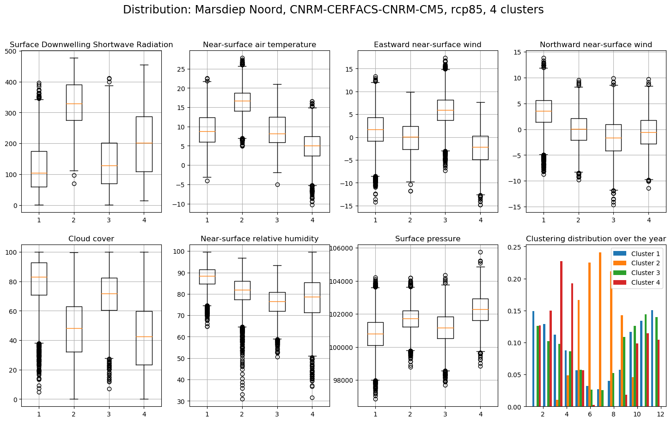
Analyzing the clusters
Now with the pessimistic scenario

Slide 8
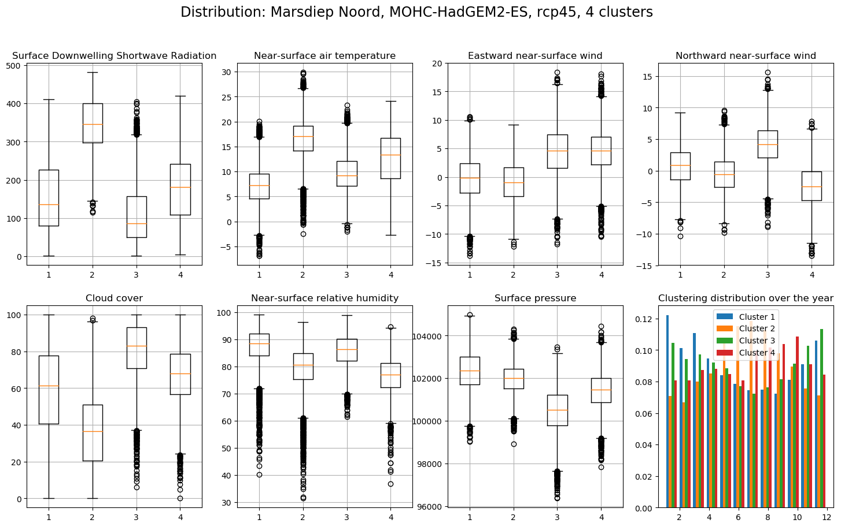

Analyzing the clusters
Now, we take the MOHC model, which predicted a high temperature rise.
As you can see, the clusters are now way more evenly distributed around the year, which indicates that similar weather occurs all-year round. Furthermore (or as a consequence), the spread is much larger the temperature.

Slide 9
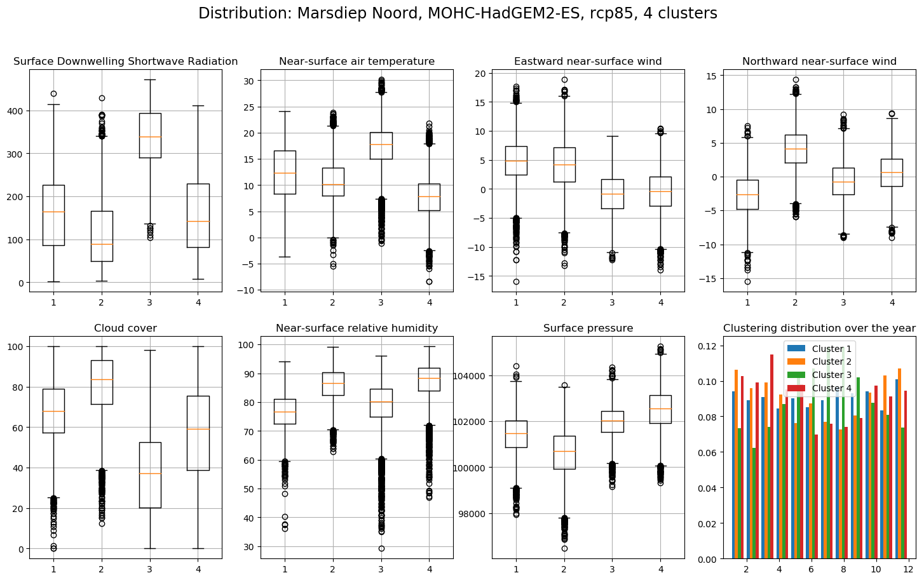

Analyzing the clusters
Now for the more extreme scenario, the same picture.
This seems to be a recurring pattern in the data. In the Github drive, all of these plots (as well as all other combinations) can be found.

Slide 10
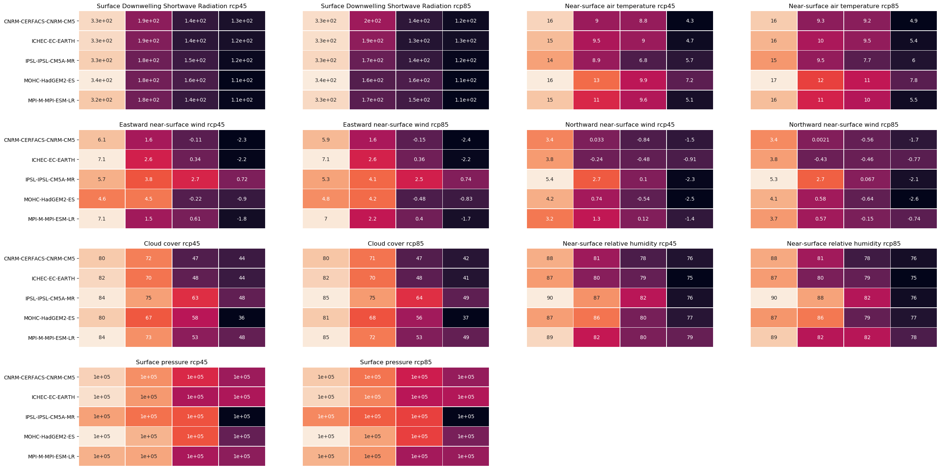
Analyzing the clusters for all models at the same time
Cluster 1
Cluster 3
Cluster 2
Cluster 4
In order to analyze and compare the different clusters, we created the following chart (zooming in may be required).
It shows the average values for all variables for all models and all scenarios when we group into 4 clusters for station Marsdiep.

Slide 11
Analyzing the clusters for all models at the same time
In order to analyze and compare the different clusters, we created the following chart (zooming in may be required).
It shows the average values for all variables for all models and all scenarios when we group into 4 clusters for station Marsdiep.
One can see that the MOHC model is different from the other models w.r.t. temperature and the IPSL in most of the other variables

Slide 12
Clustering final remarks
To Do:
Look at the KNMI/IPCC/Cordex reports in order to find nice ways of vizualizing the data
Expand the validation of the clusters
Combine the code for comparing the first and last 10 years and the code for analyzing the clusters.
Possibly ignore one (or more) variables in order to generate other clusters
Implement spatial clustering on the original dataset (when there is time left)

Slide 13
Model prediction
Furthermore, we looked into the possibility of predicting the variables from one model based on the values from another model and a part of its own history.
First steps into multi linear regression were done, however the results will be shown next week.
Other methods used are neural networks and K-means

Slide 14
Model Prediction using dense ANN’s final remarks
To do: Generalize this to different models and compare performances as well as to play around with the training set size (e.g. only having the first 100 days poses a bigger challenge since the network never gets to see certain months)
Questions that arise here: How to make the task more challenging? What other predictions could be useful in this context?

